Slide 1
Graduation Project Management System
field training at Aiu
AIE493: Field Training 2

Slide 2

Mohammed Attia 20100211

Slide 3
AGENDA
Introduction
Problem Statement
Solution
User manual
Summary

Slide 4

Why GPMS ?
Alamein International University is seeking GPMS accreditation to enhance its educational quality. The Graduation Project Management System is a web-based platform that streamlines graduation project management and evaluation in academic institutions. It provides a centralized hub for students, coordinators, and past project information, helping the university manage academic programs and track progress towards GPMS standards.

Slide 5
What GPMS
Academic institutions face challenges in managing and evaluating graduation projects due to inefficient, time-consuming, and error-prone paper-based submissions and manual evaluations. A modern, efficient solution is needed to streamline the process and improve stakeholder experience.
User Management: The system allows users to register, log in, and manage their profiles, with roles assigned as either students or coordinators.
Project Upload: Students can upload detailed information about their projects, including titles, descriptions, files, and media such as screenshots and videos.
Project Review: Coordinators have the ability to review, evaluate, and provide feedback on the submitted projects. Based on specific criteria, they can approve or reject the projects.
Project Archive: The system stores an archive of previous projects, allowing users to search through them by title, category, or rating.

Slide 6
Notifications: GPMS provides automated notifications to keep users informed about project status updates, including successful uploads, approvals, or rejections.
Streamlining Project Submission: Simplify the process of project submission for students, reducing administrative burden and ensuring timely and accurate submissions.
Efficient Evaluation Process: Provide faculty members with tools to efficiently review and evaluate projects, streamline feedback processes, and ensure consistent and fair evaluations.
Facilitating Collaboration: Foster collaboration and communication between students and faculty members, enabling seamless exchange of feedback, guidance, and support throughout the project lifecycle.

Slide 7
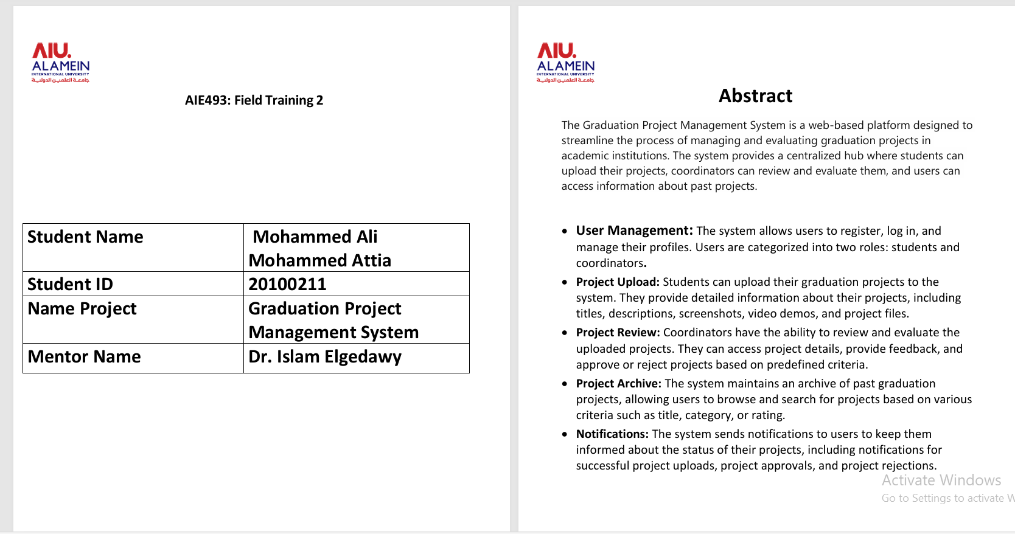
Documentation

Slide 8
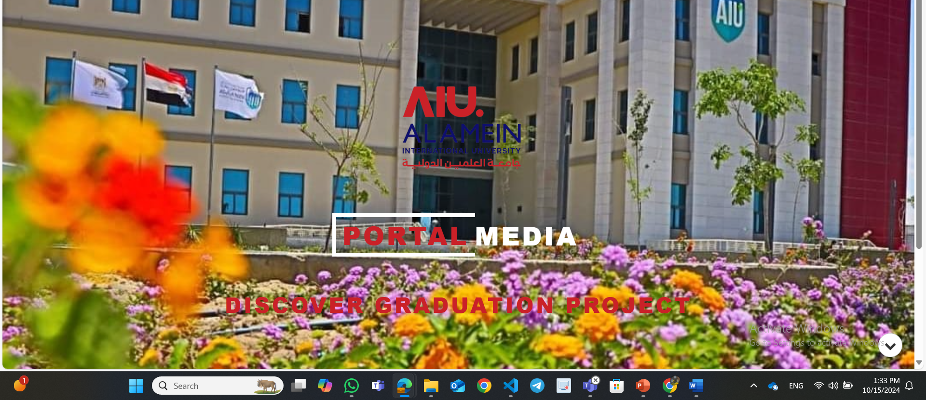
Frontend Screen Shoots
Home Page

Slide 9
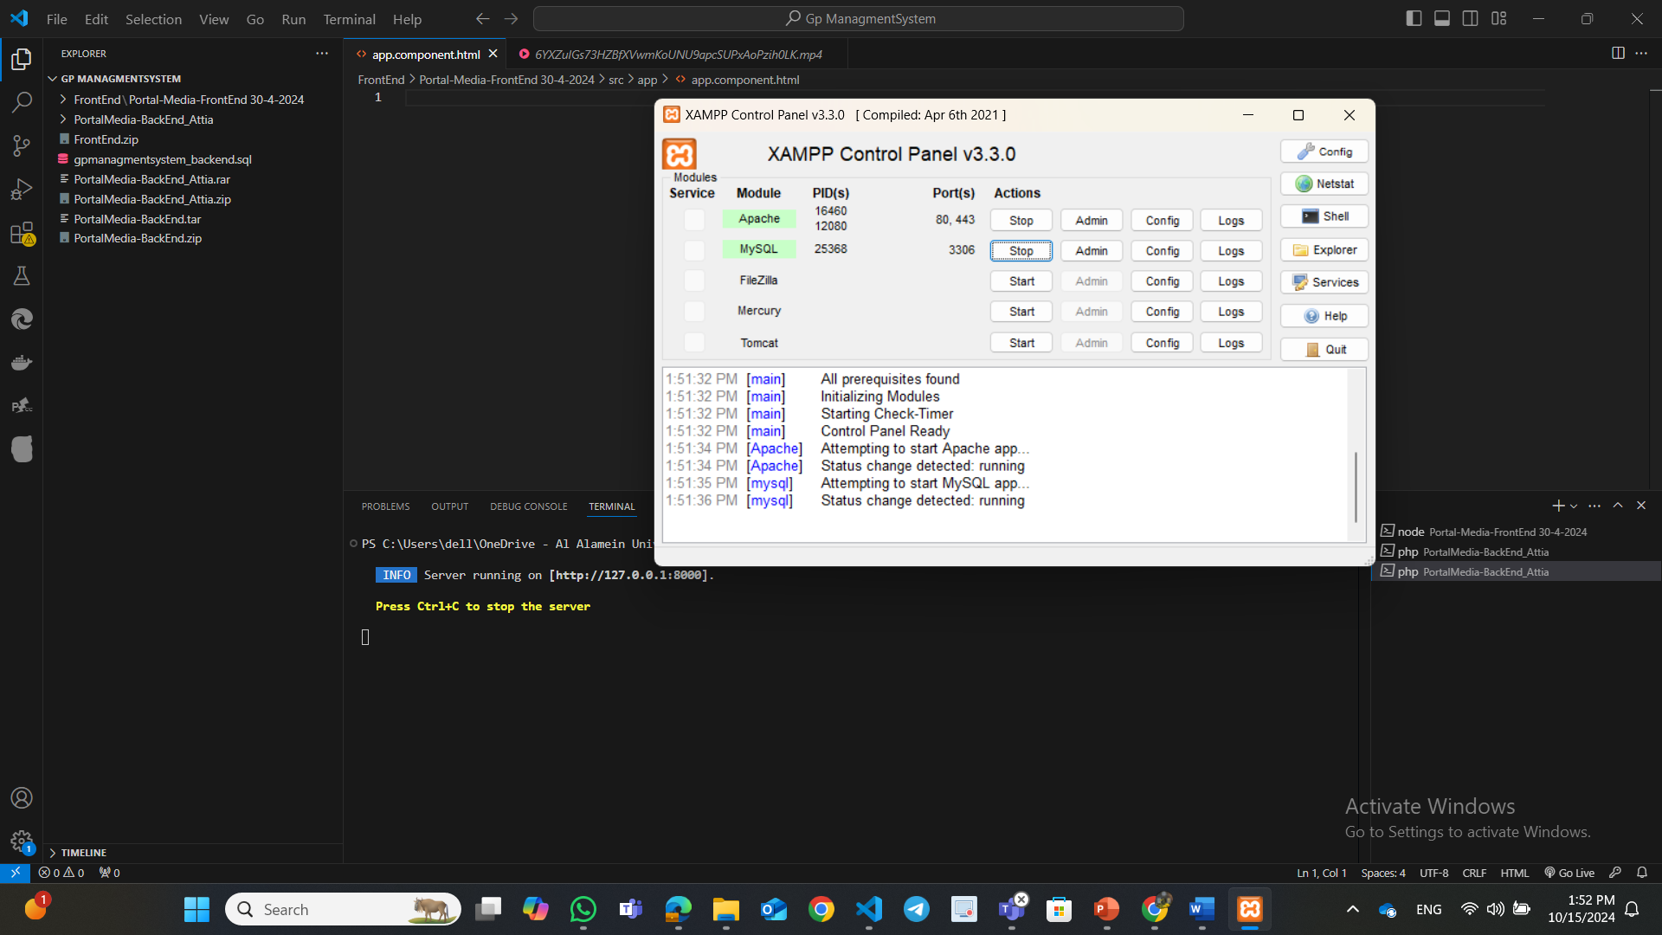
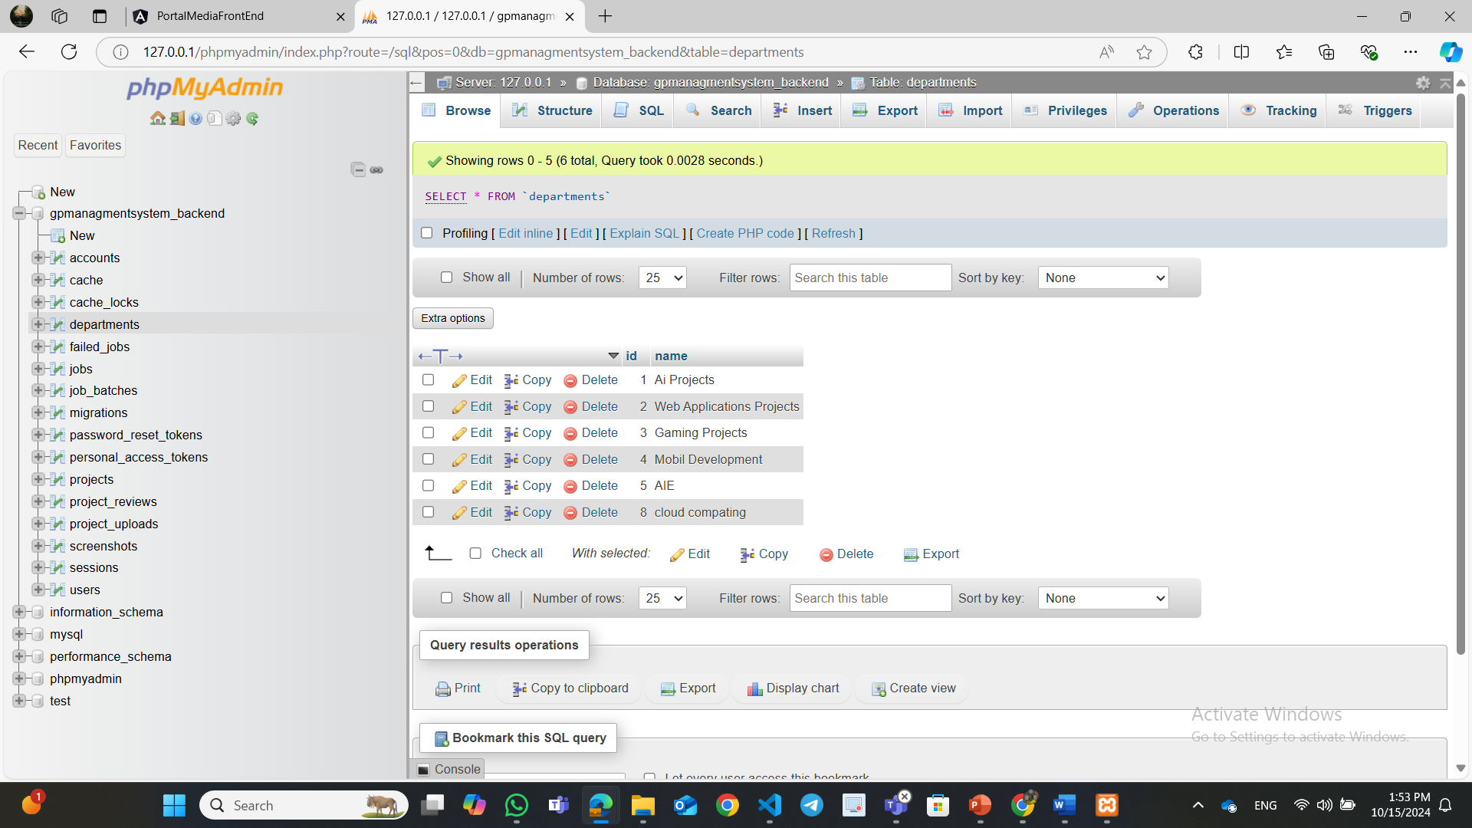
Deploying the Project

Slide 10
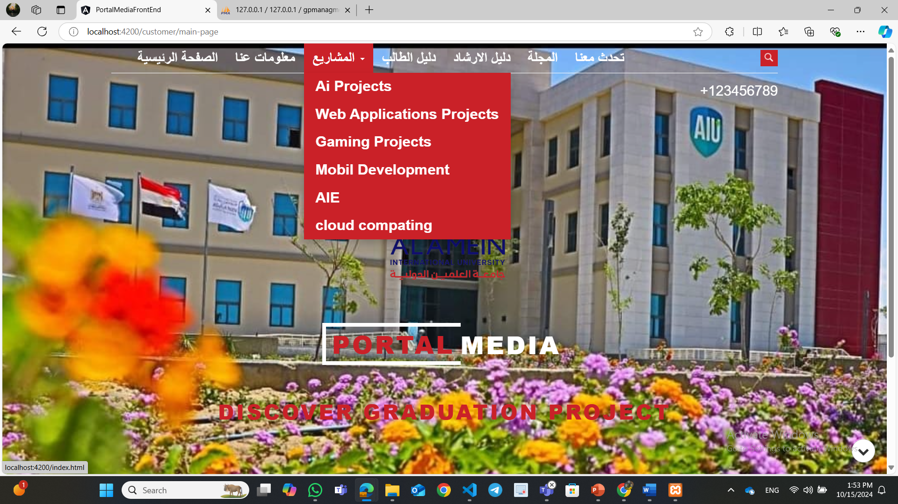
Choose Project

Slide 11
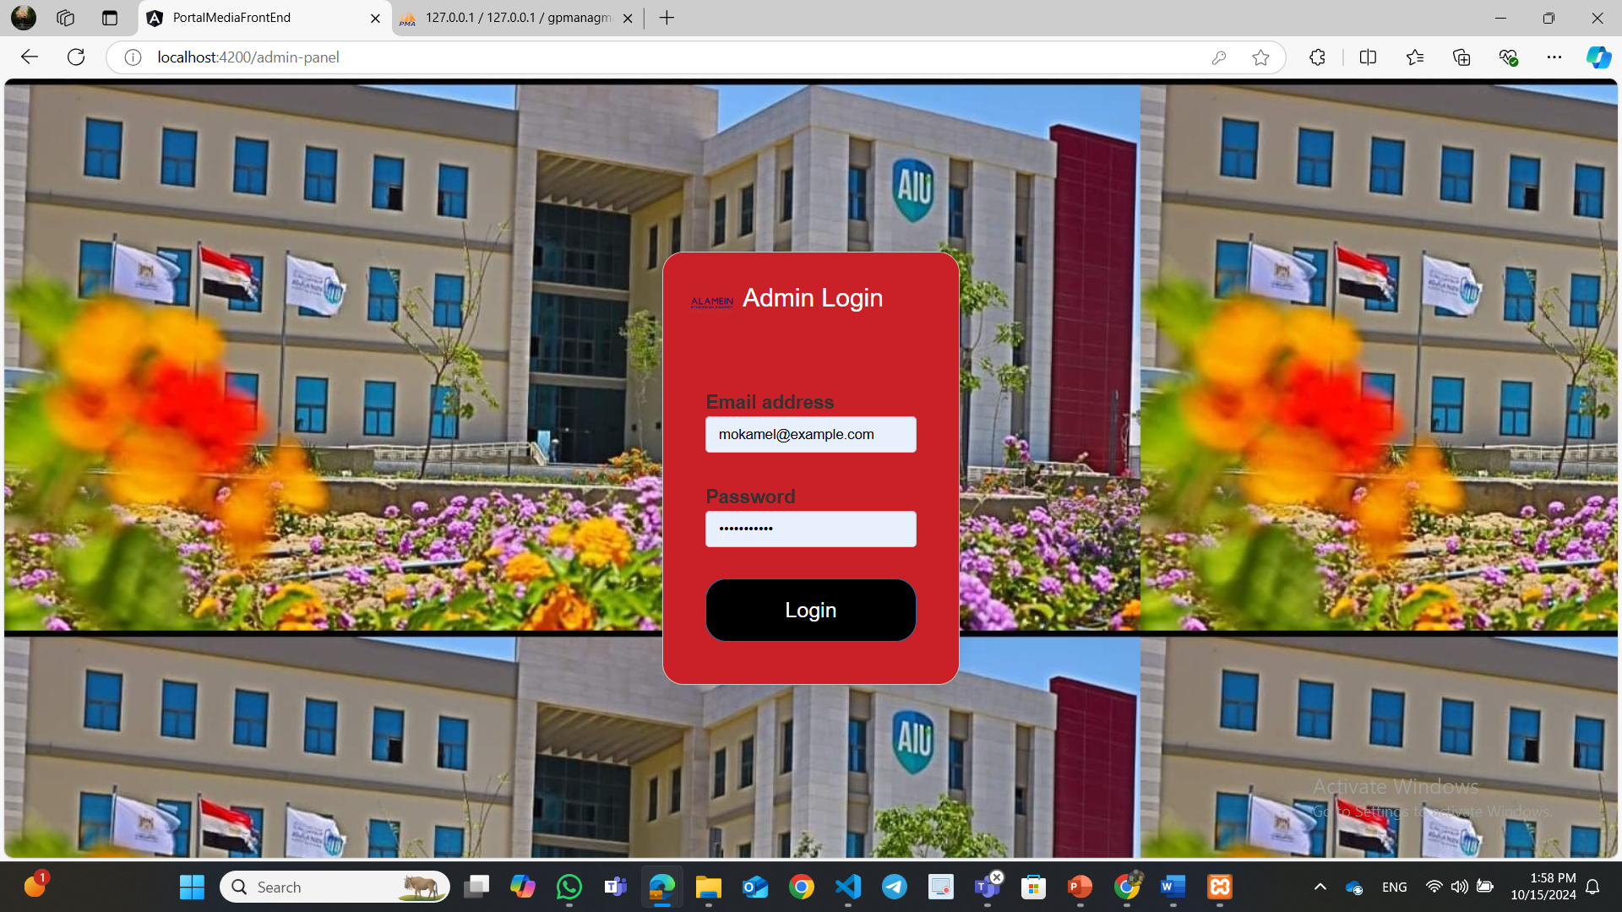
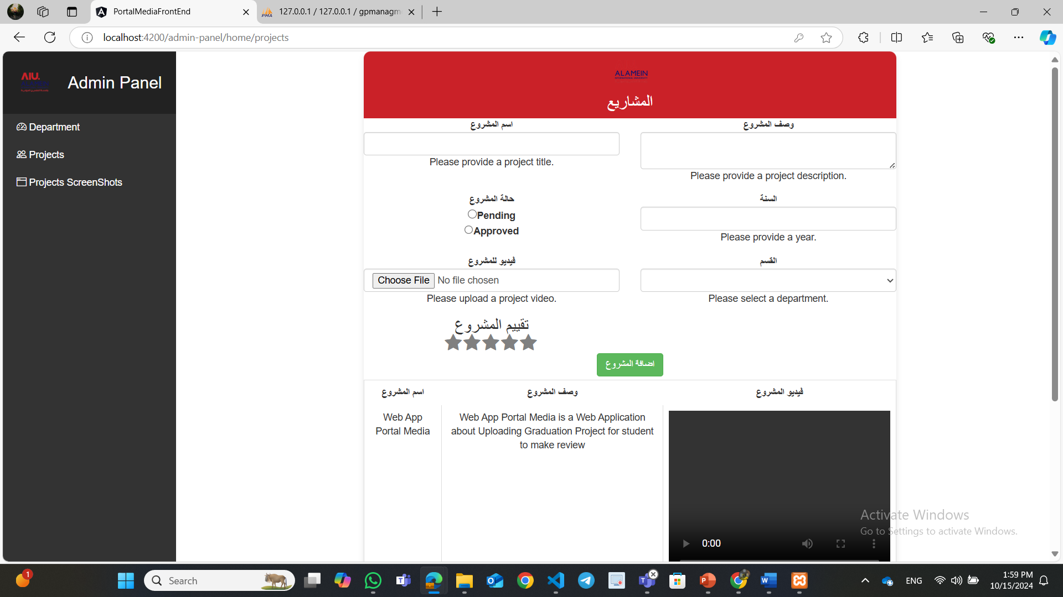
Dash Board Add Project
The Add Project section on the dashboard is a crucial part of project management, providing an intuitive interface for inputting essential project information. It is easily accessible and features a project creation form, where users can input project details such as title, description, start, end dates, status, and assignees. Users can also categorize projects by selecting tags, such as Development, Design, or Marketing. The section also allows users to upload files or documents during the creation process, ensuring smooth organization and efficient workflow management.

Slide 12
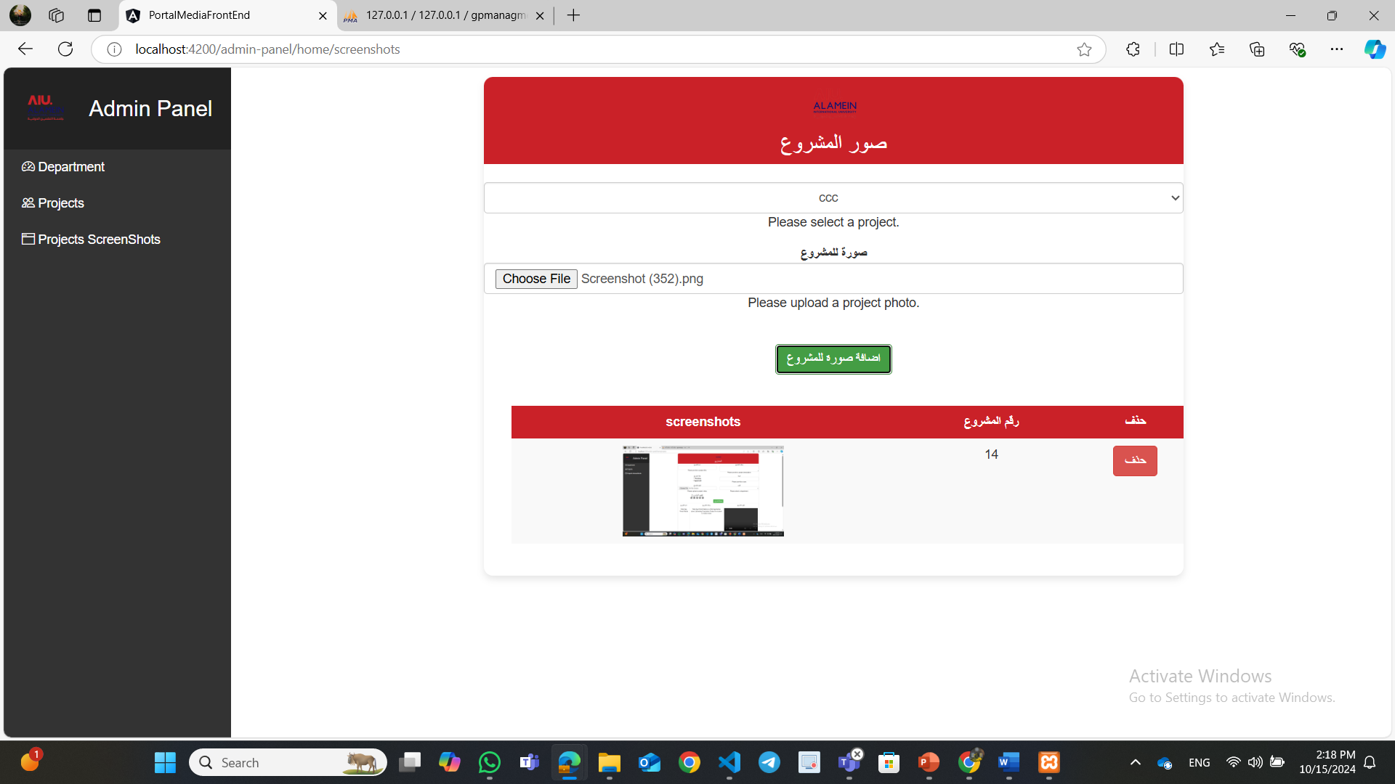
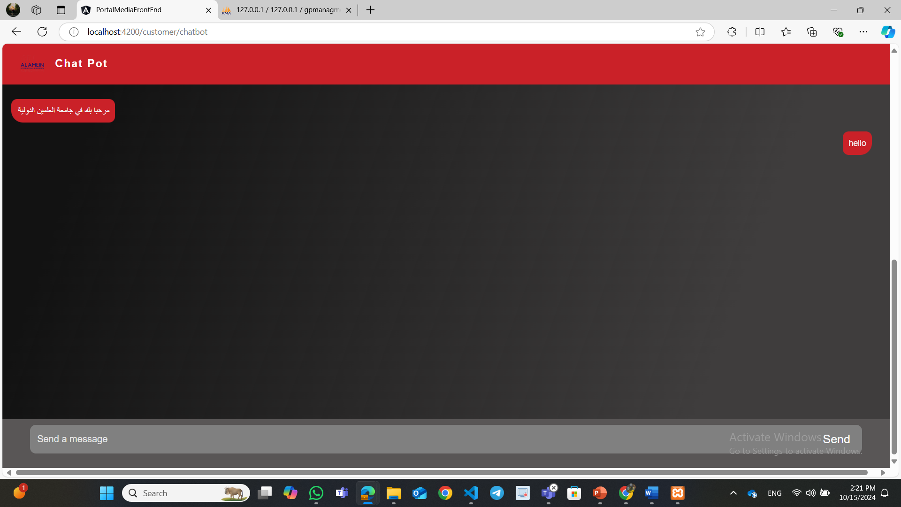
Add Project Screen shoots
Chat Pot

Slide 13
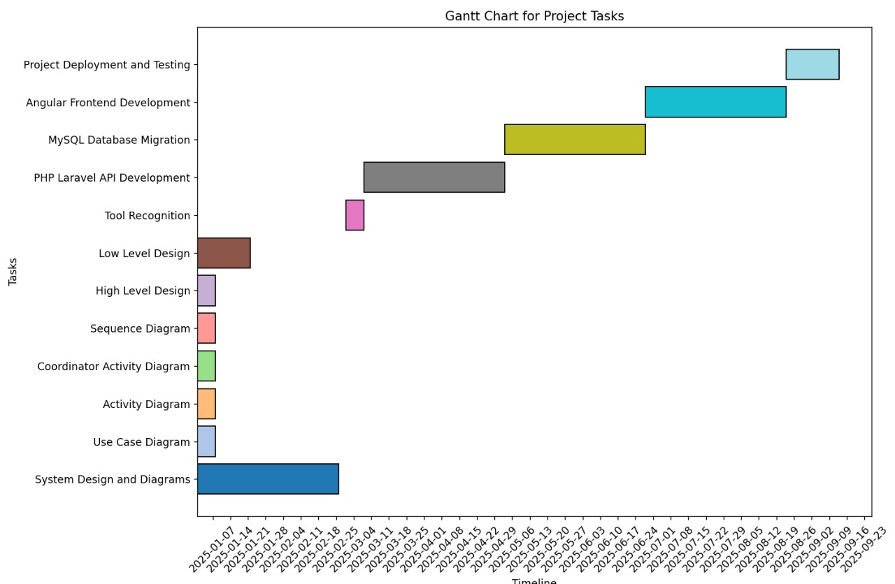
Gantt chart for project

Slide 14
Conclusion
The Graduation Project Management System offers a comprehensive solution for managing and evaluating graduation projects in academic institutions. By leveraging PHP Laravel in the backend and HTML, CSS, and Angular in the frontend, the system aims to enhance the overall experience for students, coordinators, and other stakeholders involved in the graduation project process.

Slide 15


